Slide 1
Intro to Cryptography
By Sean O’Mahoney from the Computing Society at Futures Friday

Slide 2
What?
“Cryptography is associated with the process of converting ordinary plain text into unintelligible text and vice-versa. It is a method of storing and transmitting data in a particular form so that only those for whom it is intended can read and process it. Cryptography not only protects data from theft or alteration, but can also be used for user authentication.”
– The Economic Times

Slide 3
Why & History
The first known evidence of the use of cryptography (in some form) was found in an inscription carved around 1900 BC, in the main chamber of the tomb of the nobleman Khnumhotep II, in Egypt
Fast forwarding to around 100 BC, Julius Caesar was known to use a form of encryption to convey secret messages to his army generals posted in the war front (the Caesar Cipher)
During the 16th century, Vigenere designed a cipher that was supposedly the first cipher which used an encryption key.
During the 18th the Freemasons used a cipher called Pigpen to keep their records private
At the start of the 19th century when everything became electric, Hebern designed an electro-mechanical contraption which was called the Hebern rotor machine. It uses a single rotor, in which the secret key is embedded in a rotating disc.
The Engima machine was invented by German engineer Arthur Scherbius at the end of World War I, and was heavily used by the German forces during the Second World War.
https://access.redhat.com/blogs/766093/posts/1976023

Slide 4
Modern Day
“Encryption makes the modern world go round. Every time you make a mobile phone call, buy something with a credit card in a shop or on the web, or even get cash from an ATM, encryption bestows upon that transaction the confidentiality and security to make it possible.”
- BBC
https://www.bbc.co.uk/news/technology-24667834

Slide 5
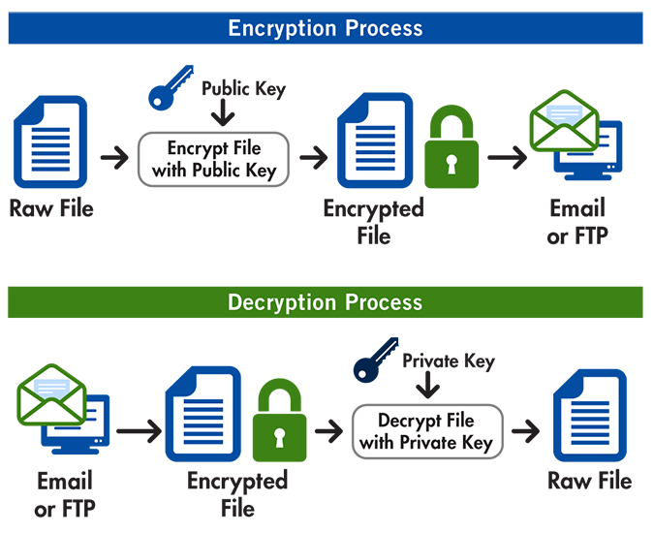
PGP (Pretty Good Protection) – HTTPS
You have a public key (to lock/encrypt the message) and a private key (to unlock/decrypt the message). You would send the public key to all your friends so that they can encrypt sensitive messages that they want to send to you. Once you receive an encrypted message, you use your private key to decrypt it.
https://medium.freecodecamp.org/how-does-pretty-good-privacy-work-3f5f75ecea97

Slide 6
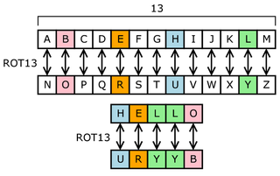
Challenge – Caesar Cipher
Ubcrshyyl lbh pna
qrpbqr guvf

Slide 7
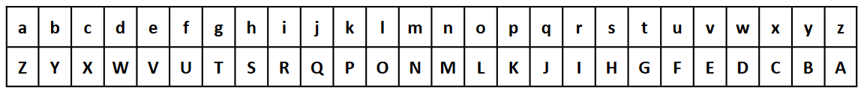
Challenge – Atbash
The Atbash cipher is a very common, simple cipher. It was for the Hebrew alphabet, but modified here to work with the English alphabet. Basically, when encoded, an "A" becomes a "Z", "B" turns into "Y", etc.
Rg'h ivozgrevob
vzhb gl wvxlwv

Slide 8
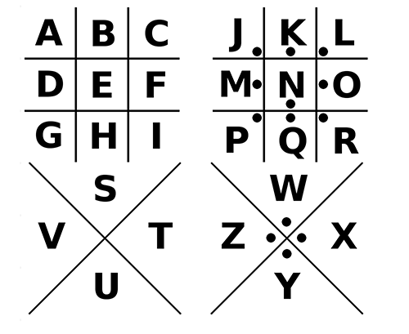

Challenge - Pigpen
https://v2.cryptii.com/text/pigpen

